Slide 1
TL 9000 Registration Creation AND Data Submission
Vijay Srikanth, Assistant Director, Institute for Data Analytics UTD
June 8th 2022

Slide 2
TL 9000 Overview
All TL 9000 registration information is entered and stored online
TL 9000 Registration Data is stored in the Registration Management System
(RMS)
TL 9000 Measurements Data is stored in a separate system called the
Measurements Repository System (MRS)
Annual data available to TL 9000 registrations free via registration
profile
Monthly data including Best-in-Class available as exclusive benefit of TIA
QuEST Forum membership

Slide 3
Steps to Registration - Login
TIA QuEST Forum Single Sign-On System
Go to https://portal.questforum.org/ on the Internet. The TIA QuEST Forum Single Sign-On System screen will be displayed.
TIA QuEST Forum Copyright Agreement page appears when the user logs first time after creating his/her account. User must accept the agreement to proceed further.

Slide 4
Steps to Registration - New User Account
TIA QuEST Forum Single Sign-On System
First, establish a personal account on the RMS
Username
Password
Name,
Address, etc.

Slide 5
Steps to Registration - Associate Account with Company
TIA QuEST Forum Single Sign-On System
Second, enter identification information about your company or associate yourself with an existing company
Note: TL 9000 Administrator will review/approve the new company account.

Slide 6
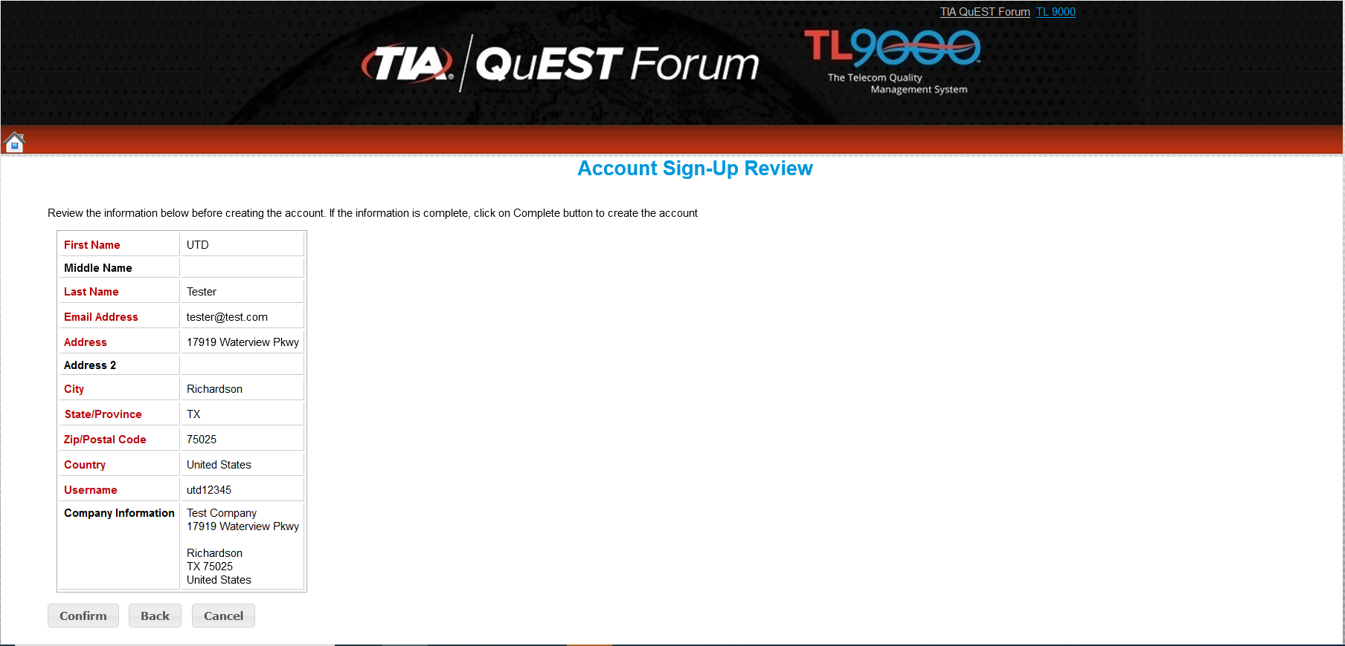
Steps to Registration - Associate Account with Company
TIA QuEST Forum Single Sign-On System
Search Company by name
Type your company name. The system will display a list of companies.
Select your company name from the listing and click “Continue” to proceed.
The Account Sign-Up Review screen will be displayed. Review your account information and click “Confirm” to submit your account application for review/approve.

Slide 7
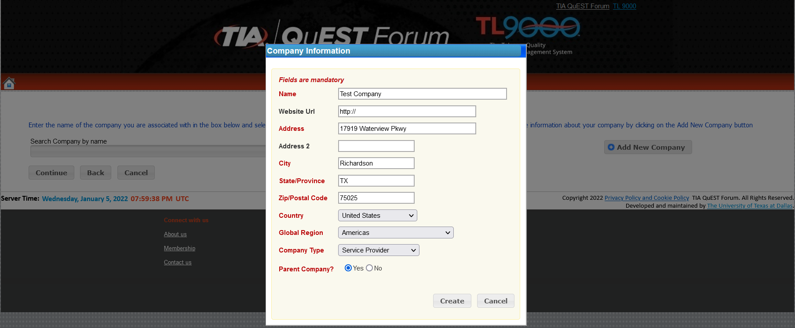
Steps to Registration - Associate Account with Company
TIA QuEST Forum Single Sign-On System
New Company Creation
Click on the “Add New Company” button. The Company Information window will be displayed.
Fill out the company information.
Parent Company: Yes
If you choose “Yes” to Parent Company and click “Create” to save, the Account Sign-Up Review screen will be displayed.
Review your user account information and click “Confirm” to submit your user account application for review/approval.
Parent Company: Yes

Slide 8
Steps to Registration - Associate Account with Company
TIA QuEST Forum Single Sign-On System
New Company Creation
Parent Company: No
If you choose “No” to Parent Company, the Company Information window will be displayed with the Parent Company search field (click Help?).
Select or fill out the parent company information. Then click “Create” to save your user account application, company information, and parent company information. The Account Sign-Up Review screen will be displayed.
Review your user account information and click “
Confirm” to submit your account application for
review/approval.

Slide 9
Steps to Registration - New TL 9000 Registration Creation
TIA QuEST Forum Single Sign-On System
Third, create a new TL 9001 registration
by clicking the ‘Registrations’ link under
the ‘Registrations Menu’ or Clicking the
‘Manage Registrations’ button on the
Dashboard

Slide 10
Steps to Registration - New TL 9000 Registration Creation
TIA QuEST Forum Single Sign-On System
Click the “TL 9000” button to select
TL 9000 as the Registration Type

Slide 11
Steps to Registration - New TL 9000 Registration Creation
TIA QuEST Forum Single Sign-On System
Third, create a new TL 9000
registration by entering the appropriate
profile information about your
registration (Step 1)
Registration Name
Accreditation Body Company
Certification Body Company
Specialty Option
Nace Code – Hardware, Software, Services
ISO Scope and TL 9000 Scope statements
Click the Continue button to proceed

Slide 12
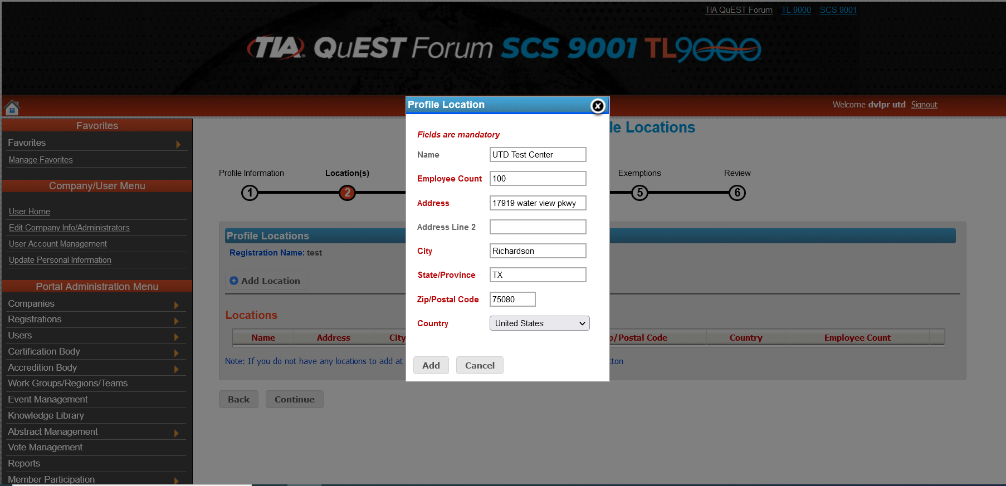
Steps to Registration - New TL 9000 Registration Creation
TIA QuEST Forum Single Sign-On System
Enter the appropriate Location(s) information (Step 2)
Click on the “Add Location” button. The Profile Location window will be displayed.
Enter the required information and click “Add” to save.
Note: You can add one or more locations to your TL 9001 registration.
Once you are done with adding profile location(s), click “Continue” to go to the next section. The TL 9000 Profile Product Categories screen will be displayed.

Slide 13
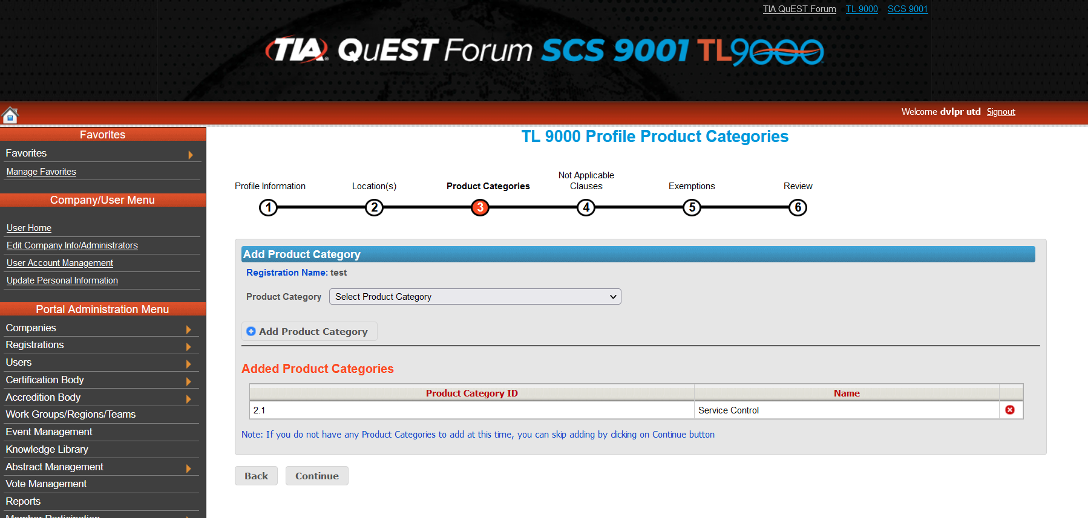
Steps to Registration - New TL 9000 Registration Creation
TIA QuEST Forum Single Sign-On System
Select the appropriate Category
(Step 3)
Select the appropriate Category from the Category drop down and click on the “Add Category” button to add the Category
Note: You can add one or more categories to your TL 9000 registration.
Once you are done with adding profile categories click “Continue” to go to the next section. The Not Applicable Clauses screen will be displayed.

Slide 14
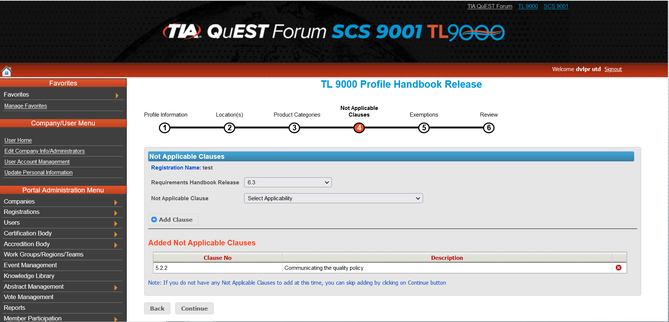
Steps to Registration - New TL 9000 Registration Creation
TIA QuEST Forum Single Sign-On System
Enter the appropriate Not Applicable Clauses information (Step 4)
Handbook Release (Not Applicable Clauses)
Select Requirement Handbook Release from dropdown
Select Not Applicable Clause from dropdown
Click ‘Add Clause’ button to add not applicable clause
Click the Continue button to proceed
Note: If your TL 9000 registration does not have any Not Applicable Clauses, you can skip this section by clicking on the “Continue” button.

Slide 15
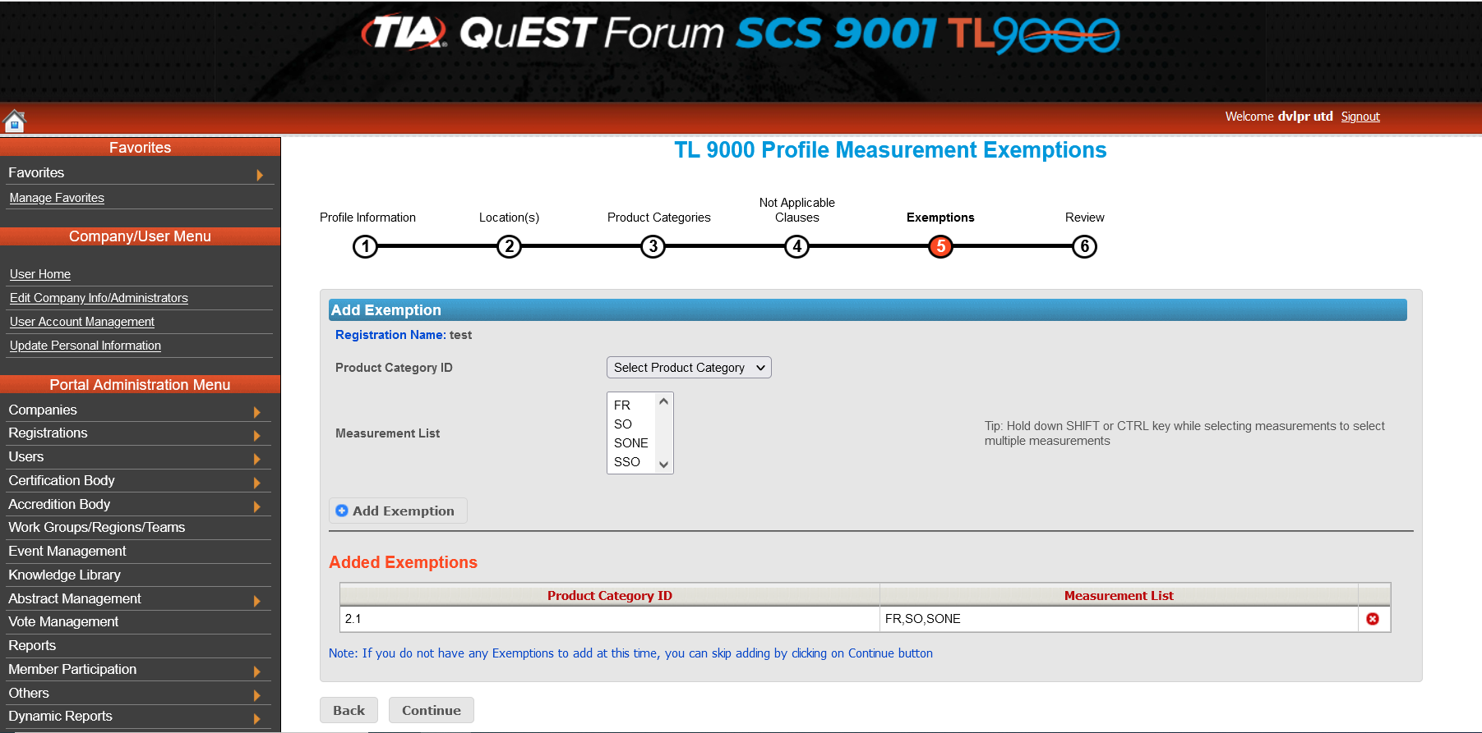
Steps to Registration - New TL 9000 Registration Creation
TIA QuEST Forum Single Sign-On System
Select the appropriate Exemptions information (Step 5)
Category ID
Measurement List
Click ‘Add Exemption’ button to add Exemption
Click the Continue button to proceed
Note: If your TL 9000 registration does not have any Exemptions, you can skip this section by clicking on the “Continue” button.

Slide 16
Steps to Registration - New TL 9000 Registration Creation
TIA QuEST Forum Single Sign-On System
Review Profile Information - TL 9000
Verify the information entered is correct and click “Submit” to save.

Slide 17
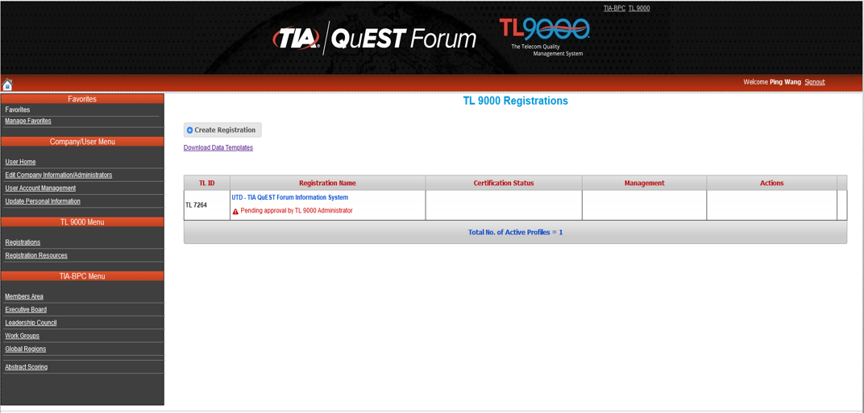
Steps to Registration - New TL 9000 Registration Creation
TIA QuEST Forum Single Sign-On System
On successful submit, a success msg is issued with the TL 9000 ID
Note: New TL 9000 Registration will be approved by the TIA QuEST Forum portal administrator

Slide 18
Steps to Registration - New SCS 9001 Registration Creation
TIA QuEST Forum Single Sign-On System
LOGIN AS USER TO VIEW/EDIT NEW TL 9000 REGISTRATION
After your TL 9000 registration has been
approved by the TIA QuEST Forum
Administrator, you can login to the TIA QuEST
Forum portal and view it.
Login to https://portal.questforum.org
using your username and password. The
User Portal Home Page screen will be
displayed.
Under the “Registration Menu” section and
click on the “Registrations” link. The
Registrations home page will be displayed.

Slide 19
TL 9000 Data Submissions - Methods
There are three methods available for submitting monthly TL 9000 data to the
Measurements Repository System (MRS)
The three methods are:
Manual – the data is entered manually through an input form on-line
Template – the data is entered into a template file and then uploaded
XML – an XML based file is loaded via a machine to machine
The above three methods may be used interchangeably. For example, one method may
be used for the original submission and another method may be used for a re-submission.
One method may be used one month and another the next month. It is recommended
though that once an automated XML based input system is set up that it be used
consistently

Slide 20
Registration Management - Submit Data

Slide 21
TL 9000 Data Submissions - Online Data Submission
First collect all the necessary data
Log in to the TIA QuEST Forum portal at https://portal.questforum.org/
Click on “Registrations” link found on the left side menu, opens the
TL 9000 Registrations page
Select the registration
Click on "Submit Data" link found in the Actions column against the
registration you will submit data for
The "TL 9000 Data Submission" page appears, and the “Online Data
Submission” tab is highlighted.
Select the year and the month

Slide 22
TL 9000 Data Submissions - Online Data Submission (continued)
First collect all the necessary data
Log in to the TIA QuEST Forum portal at https://portal.questforum.org/
Click on “Registrations” link found on the left side menu, opens the TL 9000
Registrations page
Select the registration
Click on "Submit Data" link found in the Actions column against the registration
you will submit data for
The "TL 9000 Data Submission" page appears, and the “Online Data
Submission” tab is highlighted.
Select the year and the month

Slide 23
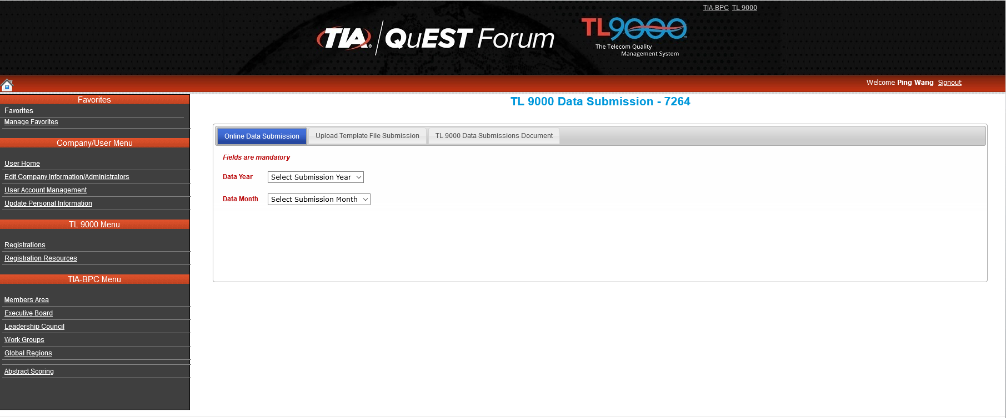
TL 9000 Data Submissions - Online Data Submission (continued)

Slide 24
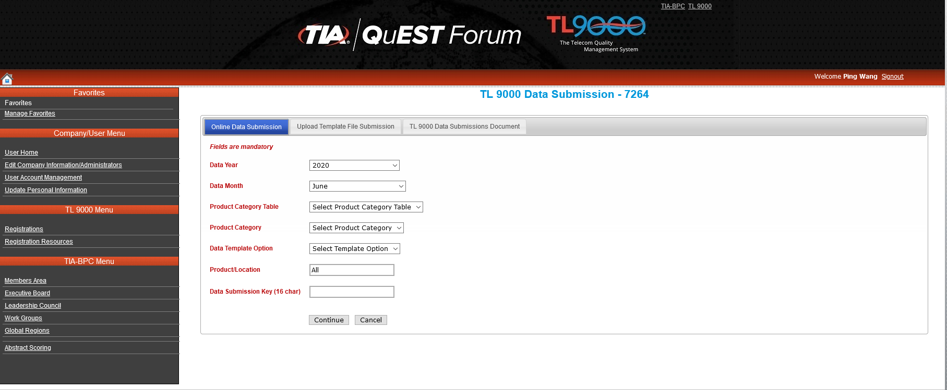
TL 9000 Data Submissions - Online Data Submission (continued)

Slide 25
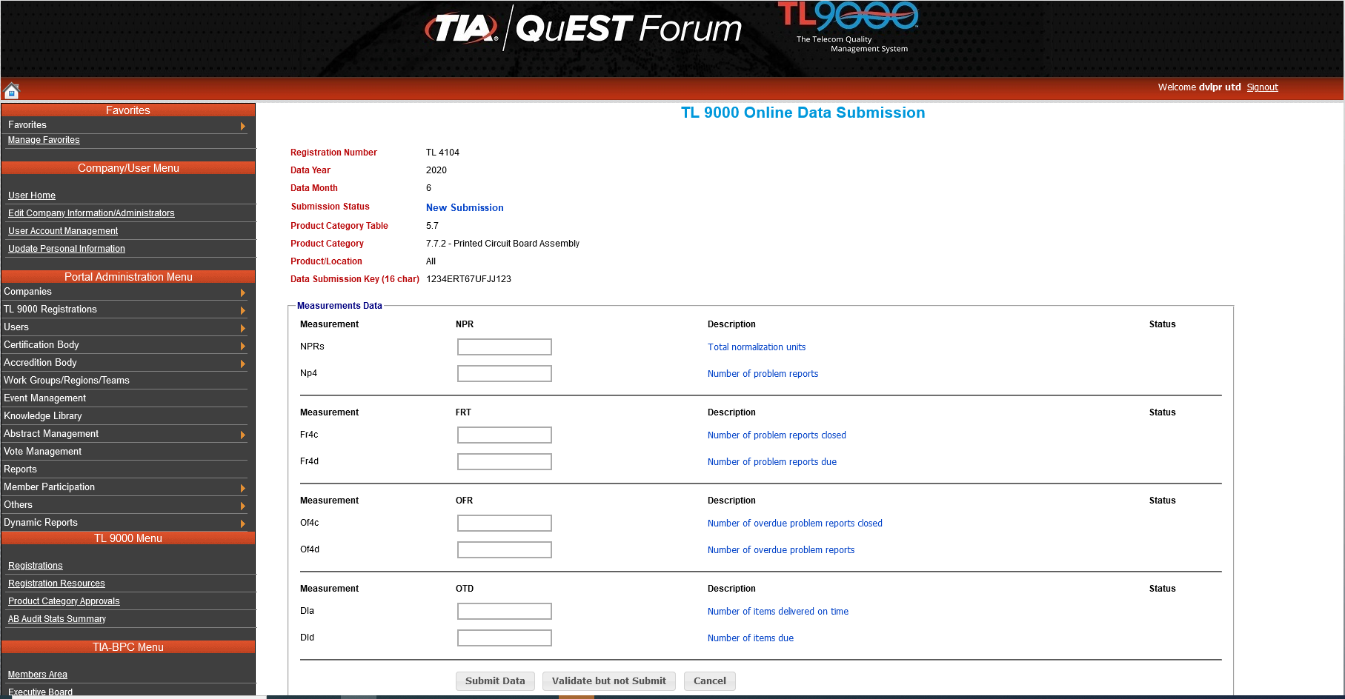
TL 9000 Data Submissions - Online Data Submission (continued)
Submit
validate

Slide 26
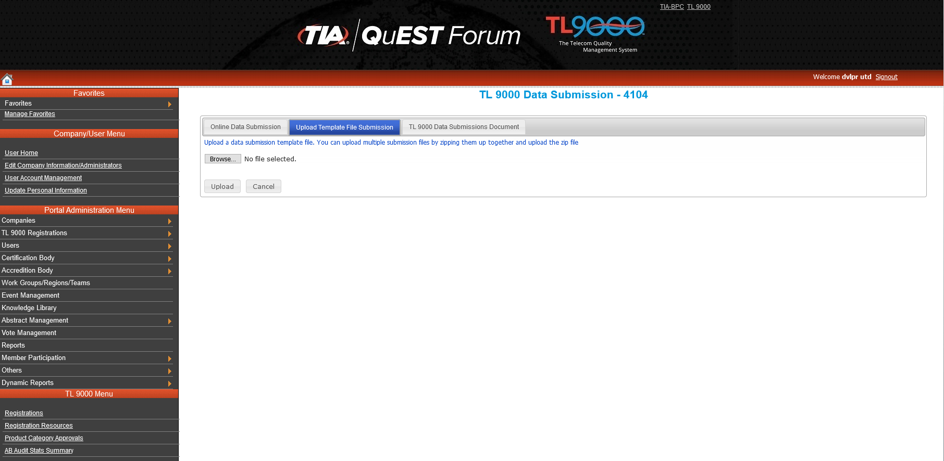
Data Submissions – File Upload (continued)

Slide 27
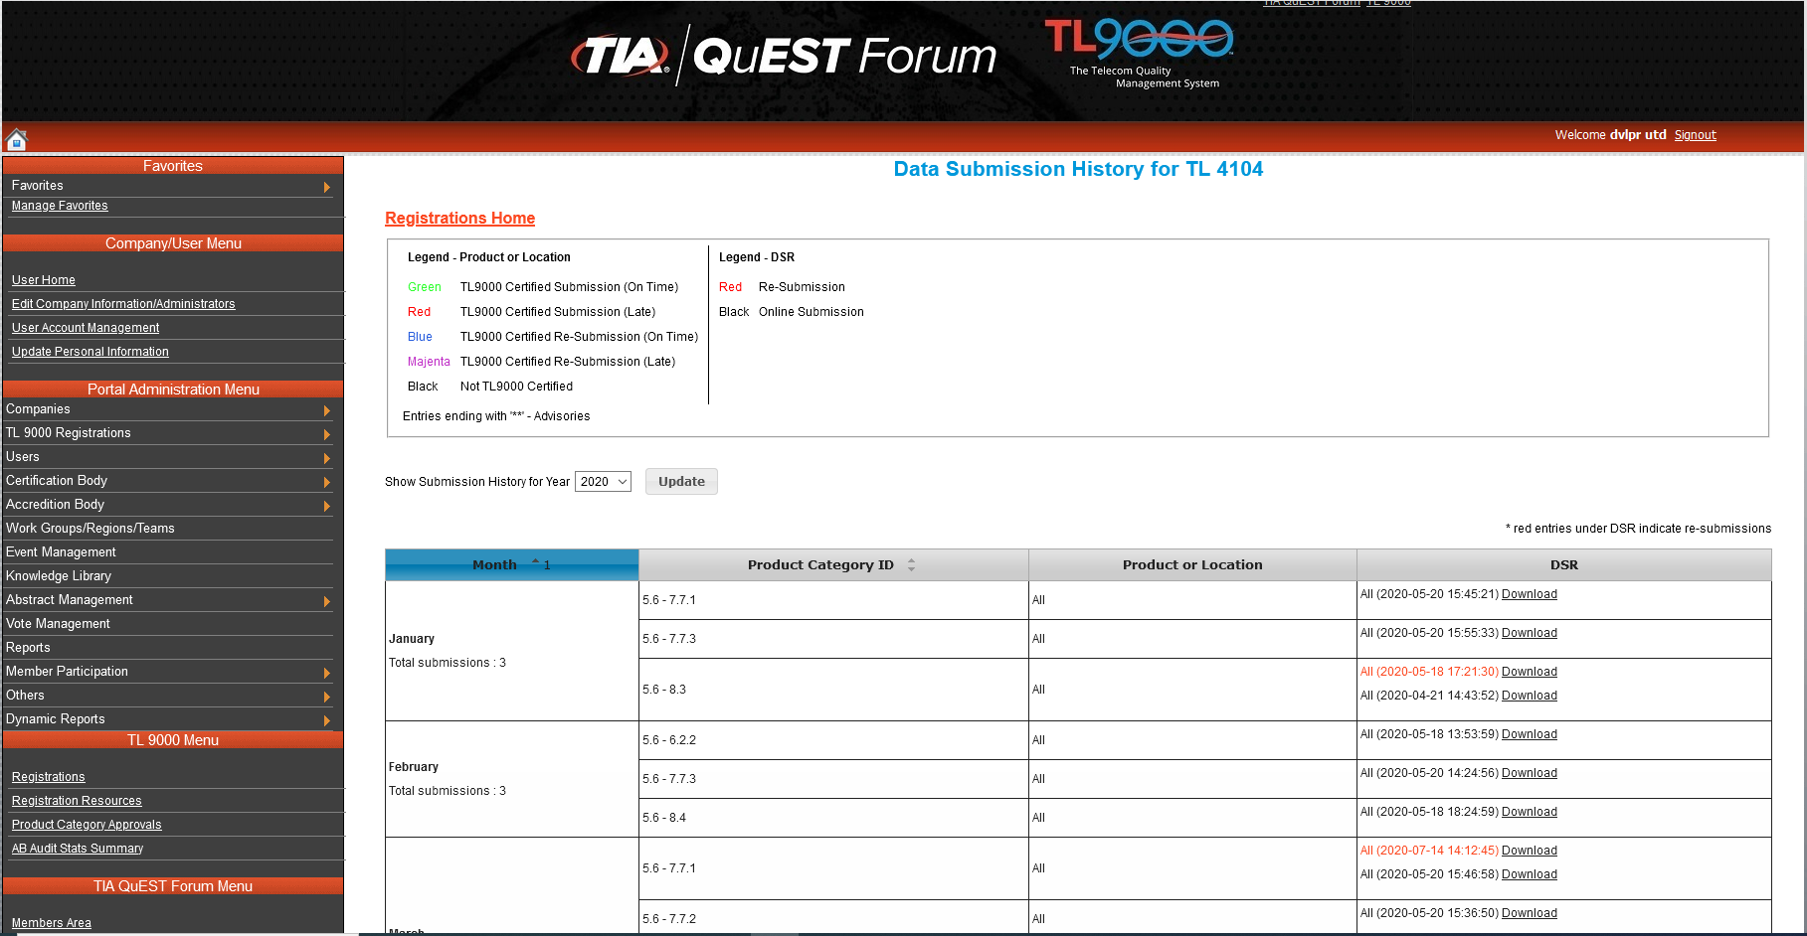
Registration Management – DSR History
DSR

Slide 28
TL 9000 Certification
You’ve registered
You’ve completed TL 9000 preparations
You’ve submitted three consecutive months of TL 9000 data
You’ve passed your certification audit
What next?
Your auditor from the Certification Body company must log in and certify
your registration online
You will receive e-mail notification when done.
Look for your registration on the public side.

Slide 29
Certification Body – Approvals
Once certified, an Organization can edit their private registration profile, which is
visible only to approved registration administrators within the organization and
their Certification Body (CB)
The following fields can be edited by the Organization:
Registration Name, Specialty Option, Not Applicable Requirements,
Exemptions, Certification Body Name, Accreditation Body Name, Nace Code –
Hardware, Nace Code – Software, Nace Code – Services, ISO Scope, TL 9000
Scope, Adding or modifying location(s), Adding Categories, Link new
Profile, Primary Registration Administrator and Alternate Registration Administrator

Slide 30
Certification Body – Approvals
Changes to the following fields must be approved by the CB before they
are shown in the public certified profile:
Registration Name, Specialty Option, Not Applicable Requirements,
Exemptions, Certification Body Name, Nace Code – Hardware, Nace Code –
Software, Nace Code – Services, ISO Scope, TL 9000 Scope, adding or modifying
location(s), adding Categories and Link new Profile
Changes to the following fields will immediately flow to the public certified profile:
Primary Registration Administrator, Alternate Registration Administrator, deletion of
Location(s) and deletion of Categories

Slide 31
Contact Information
Use Contact Button on every page of tl9000.org to
Ask questions
Make suggestions
Report problems

Slide 32
Does your company operate in the ICT space? Are you a TIA QuEST Forum member? If not, sign up today and reap the immediate benefits of membership.
For additional information, please visit: www.tiaonline.org
www.tl9000.org

